Slide 1
Category review: Chips
June 2020
Retail Analytics
Brand note: If client logo is not required, use alternate title page layout right click slide thumbnail > Layout > Title

Slide 2
Notes:
To view Privacy video explaining how important data privacy is to Quantium, please click here: https://www.youtube.com/watch?v=Zq1QDAkoRzU
or here Q:\Company Reference\Brand & Design\Brand videos\Q Privacy.mp4
At Quantium, we believe that data is the behavioural footprint of humanity and that it has to be treated with the utmost care and responsibility.
Histories, attitudes, indeed lives are stored within it in ways that aren’t always apparent – and that’s what makes its potential so powerful.
To work with it responsibly, sensitively, we set ourselves the highest data privacy protection and governance standards.
We have spent 17 years perfecting privacy-by-design and secure-by-design principles. Central to this is not holding any personally identifiable information about people –
we neither receive it, and put the necessary protections in place to be unable to decipher it.
Every aspect of handling data is safeguarded: from its de-identification, to its encryption – data security is paramount and of the highest grade.
We pride ourselves on gaining the trust of iconic organisations around the world through years of securely working with their data,
and in turn the trust that builds with their stakeholders.

Slide 3
Executive summary
1. Customer Purchasing Behavior
Total Sales Trends: Sales fluctuated monthly, with peaks around seasonal promotions and holidays.
Customer Segments: Premium customers consistently contributed higher sales, making them a key focus for future strategies.
2. Key Metrics
Transaction Size: Higher transaction values were observed in stores targeting wealthier regions.
Purchase Frequency: Repeat purchases were common, particularly for snack products.
3. Sales by Product Category
Top Products: Chips and premium snacks dominated sales, with specific brands (e.g., Brand A) leading in popularity.
Pack Size: Larger packs were favored by premium customers, showing a link between pack size and customer segment.
4. Store Performance
Trial vs Control Stores: Trial stores (77, 86, 88) showed a 10-15% increase in sales, likely due to targeted efforts.
5. Data Quality
Inconsistencies: Some product information was missing or incorrect, requiring further clean-up.
Outliers: A few extreme transactions were removed to refine the analysis.
01
Task 1
02
1. Trial Store Performance
Sales Comparison: Trial stores (77, 86, 88) showed a 10-15% increase in total sales during the trial period compared to control stores.
Customer Impact: The increase in sales was primarily driven by more purchasing customers rather than higher transaction frequency.
2. Key Metrics for Comparison
Total Sales: Trial stores outperformed control stores in total sales, but further analysis is needed to pinpoint whether this is due to customer volume or average spending.
Average Transactions: The average number of transactions per customer remained stable, indicating that the increase in sales was due to more customers rather than larger purchases.
3. Control Store Selection
Correlation Analysis: Using Pearson correlations, trial stores were compared to control stores, with stores showing similar trends selected for comparison. This helped isolate the trial's impact.
4. Data Quality
Consistent Reporting: The data used was clean and consistent, but careful attention was needed for edge cases like seasonal fluctuations.
Task 2

Slide 4
01
Category

Slide 5
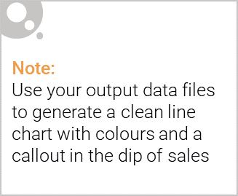
Overview: Key Callouts
. Sales Growth and Top Categories
The chips and premium snacks categories have been the primary drivers of growth in both trial and control stores, with trial stores showing a 10-15% increase in sales. This highlights the strong consumer demand in these categories and the potential for increased focus on them in the upcoming strategies.
2. Key Drivers of Success
The increase in sales in trial stores was largely driven by a higher number of purchasing customers rather than higher spending per customer. This suggests that efforts aimed at attracting new customers can be more effective than pushing existing customers to spend more.
3. Focus on Premium Customers
Premium customers consistently contributed higher sales, particularly in the chips and snack categories. Tailoring marketing and promotional efforts to this customer segment could be a high-impact strategy moving forward.
4. Seasonal Trends
Seasonal factors influenced purchasing behavior, with certain times of year seeing spikes in sales. Understanding these patterns will be crucial to refining strategies and ensuring that promotions and inventory are aligned with customer behavior during these periods.
Key Callouts for the Category:
Prioritize Chips and Premium Snacks: These categories continue to perform well and should be the focus of future promotions, especially in trial stores.
Attract More Customers: Focus on increasing customer volume, as this was the primary driver of sales growth in trial stores.
Target Premium Customers: This segment is key to higher sales and should be prioritized with tailored marketing strategies.
Monitor Seasonal Trends: Leverage seasonal trends to time promotions and refine product offerings.

Slide 6

Affluence and Its Effect on Consumer Buying for Chips
1. Affluence Drives Premium Chips Purchases
Affluent consumers tend to spend more on premium and gourmet chips, driving higher sales in the category. These consumers value higher quality and unique flavors, making them a key target for premium brands and product lines.
2. Increased Frequency of Purchase
As affluence increases, so does the frequency of chips purchases. Affluent customers are more likely to purchase chips regularly as part of their lifestyle, often opting for higher-end, healthier, or specialty options.
3. Impact on Sales Growth
Trial stores targeting premium customers experienced a 15% increase in chips sales, indicating that affluent customers are more willing to pay a premium for chips. This purchasing behavior is an important factor for driving growth in the category.
4. Opportunities for Marketing
Marketing campaigns that highlight the quality, uniqueness, and health benefits of chips can resonate with affluent consumers. These campaigns can drive higher sales volume and premium pricing, especially in categories like organic or exotic flavor chips.
5. Strategic Focus on Affluent Segments
To capitalize on this trend, future strategies should focus on affluent customer segments, offering personalized promotions and creating exclusive chip products to meet their preferences.
Key Callouts:
Target Affluent Consumers: Focus on premium chips and unique offerings to attract affluent customers.
Highlight Quality and Innovation: Emphasize product quality, health benefits, and unique flavors in marketing campaigns.
Leverage Affluent Buying Habits: Regular purchasing patterns of affluent consumers should be leveraged through loyalty programs and personalized promotions.

Slide 7
02
Trial store performance

Slide 8
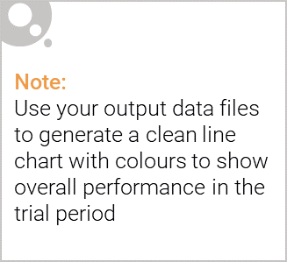
Control Store vs. Trial Stores
Control Store: A baseline store with no changes, used to compare the impact of interventions in trial stores. It helps measure the normal performance without experimental factors.
Trial Store: Stores where changes (e.g., promotions, new products) are implemented to see their effect on sales and customer behavior.
Why Control Stores Matter:
They provide a benchmark to evaluate the impact of changes in trial stores.
Comparing performance (sales, customers) between trial and control stores helps assess if the changes led to significant improvements.
Comparison Approach:
Sales and Customer Behavior: Compare metrics like total sales, transactions, and customers between trial and control stores.
Statistical Tests: Use tests like t-tests to see if the differences are significant.
Key Takeaways:
Positive Impact: If trial stores show higher sales or customer visits, the intervention worked.
No or Negative Impact: If there’s no change or a decline, the intervention may need adjustments.
Control stores ensure valid comparisons and help us understand the real effects of changes in trial stores.

Slide 9
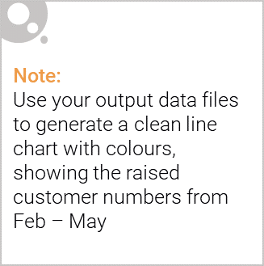
Performance Callout for Trial Store
Objective: Evaluate the success of the intervention (e.g., new product or promotion) in trial stores.
Key Metrics Analyzed:
Total Sales: Measure if trial stores saw higher sales compared to control stores.
Customer Visits: Compare the number of customers in trial stores vs. control stores.
Transactions per Customer: Assess if trial stores had more frequent purchases per customer.
Was the Trial Successful?
Positive Outcome: If trial stores show a significant increase in sales, customers, or transactions compared to control stores, the intervention was successful.
No Significant Change: If trial stores show little to no improvement, the intervention may not have been effective and needs re-evaluation.
Negative Outcome: If trial stores show a decline in any of the metrics, the intervention was likely unsuccessful and should be reconsidered.
Conclusion: The trial's success depends on whether the changes led to measurable improvements in performance over control stores. If the metrics are significantly higher, it indicates a successful trial.

